Slide 1
CSCI 347: Data Mining
Course orientation

Slide 2
What is Data Mining?
“the process of finding valid, novel, useful, and potentially understandable patterns in data” — G. Piatetsky-Shapiro, KDnuggets
“algorithms for learning, analysis, data management and visualization of large datasets” — C. Faloutsos, CMU
“Discovery of useful, possibly unexpected, patterns in data” — J. Ullman, Stanford
“providing tools to discover knowledge from data” - J. Han in his textbook, Data Mining: Concepts and Techniques
“the process of discovering insightful, interesting, and novel patterns, as well as descriptive, understandable, and predictive models from large-scale data” — M. J. Zaki and W. Meira Jr. in Data Mining and Analysis: Fundamental Concepts and Algorithms

Slide 3
Like how mining gold is digging through earth and rock for the valuable bits, Data mining is sorting though large data sets to find valuable information.
Marketing
Risk Management
Fraud detection
Cybersecurity
Medical diagnosis

Slide 4
Data Mining steps
Decision making
Data presentation – visualization
Data mining – Information discovery.
Data exploration – statistical summary, querying and reporting
Preprocessing – Data cleaning using statistical techniques or data mining algorithms.
Selection of data sources

Slide 5
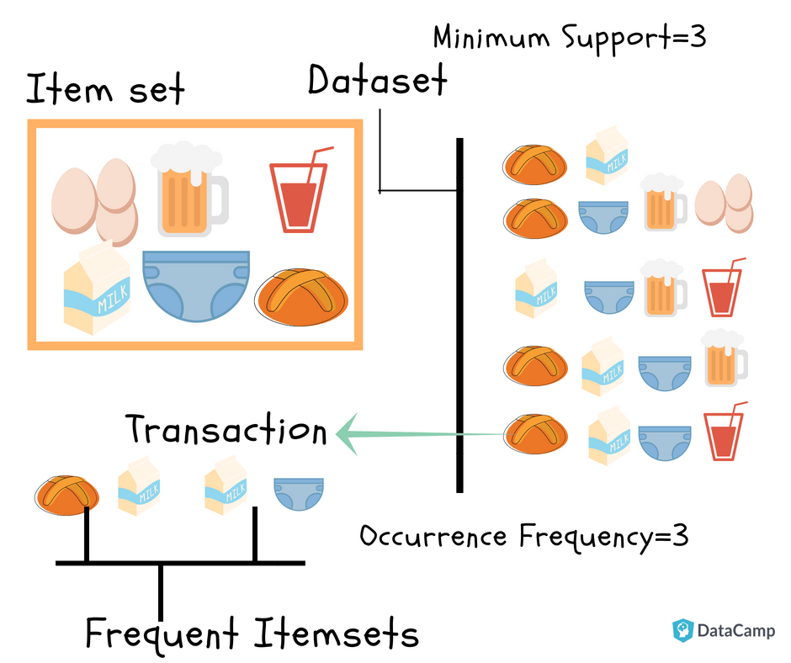
Data Mining Application: Market basket Analysis
https://www.datacamp.com/tutorial/market-basket-analysis-r

Slide 6
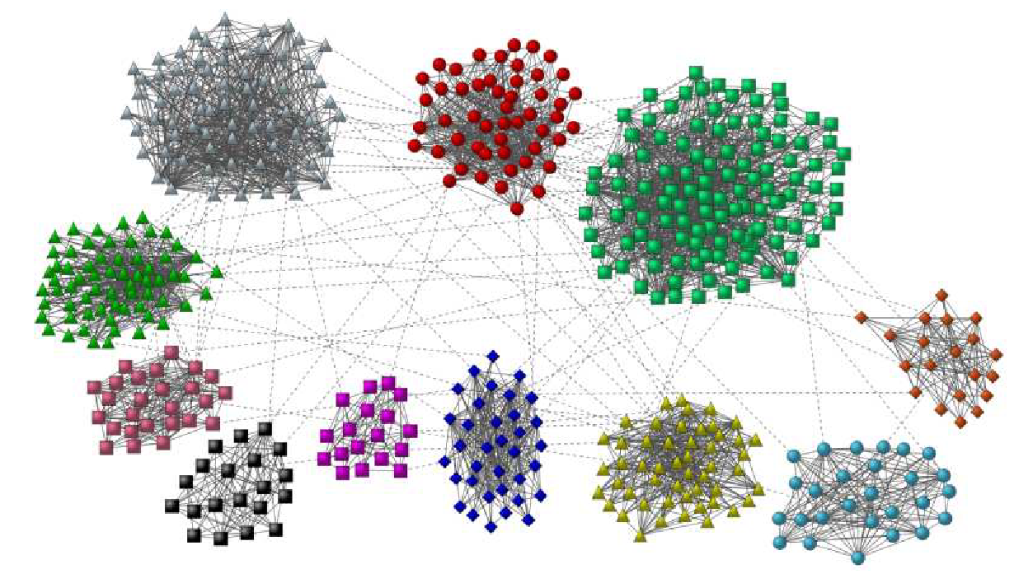
Data Mining Application: Finding communities in social network
Image taken from: Community detection in graphs, Fortunato, Santo

Slide 7
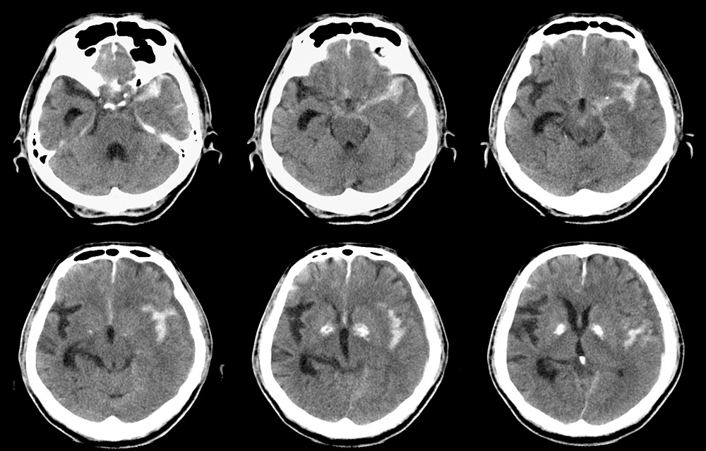
Data Mining Application: Anomalies in healthcare data
Deep learning algorithms can identify abnormalities on head computed tomography (CT) scans in patients who present with head trauma or stroke symptoms, according to study results published in the Lancet*.
https://www.thelancet.com/journals/lancet/article/PIIS0140-6736(18)31645-3/fulltext

Slide 8
Concept Maps
“Concept map is a graphical tool for organizing and structuring knowledge by depicting concepts as nodes, and relationships between concepts as edges” – Wei et al. in Concept mapping in computer science education.

Slide 9
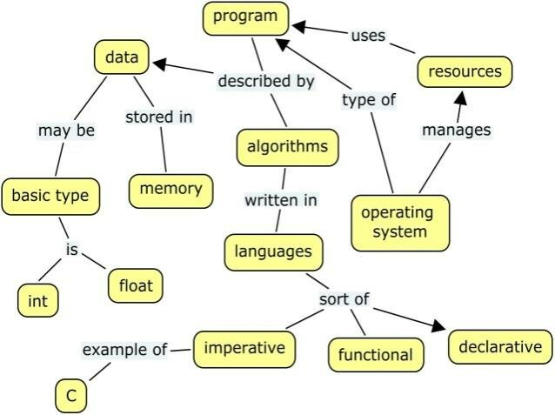
Example concept maps
CM for operating systems - An Evaluation Methodology for Concept Maps Mined from Lecture Notes: An Educational Perspective

Slide 10
Activity: Let’s create a data mining concept map
CM helps to visualize important concepts related to a theme.
Work with people around you.
Think about following questions:
What are applications in data mining ?
What are the foundational skills required to be an expert in this area ?
Programming languages
Mathematical skills etc.
What are the topics related to Data mining that comes to your mind?
What are challenges in Data mining ?

Slide 11
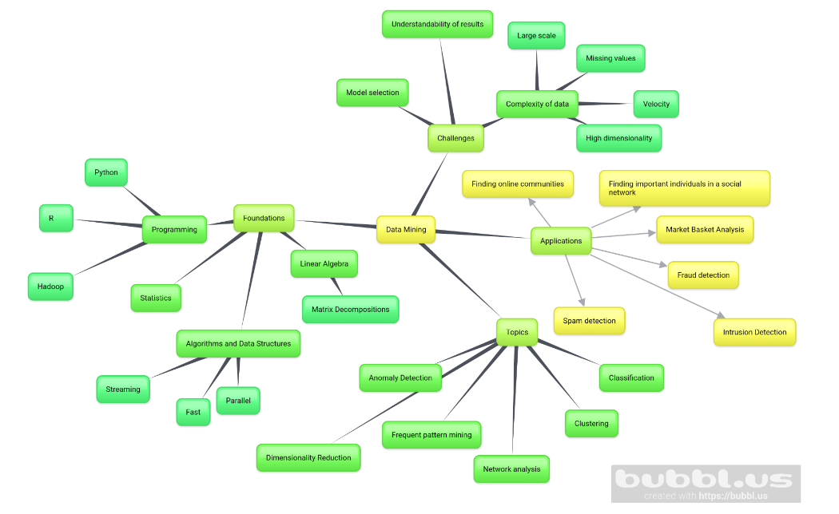

Slide 12
Summary
Topics: Common data formats, exploratory data analysis, data preparation, graph analysis, dimensionality reduction, clustering, classification and few advanced topics.

Slide 13
Instructor details
Adiesha Liyanage
Email: a.liyanaralalage@montana.edu
Office hours:
Monday 12:15 PM-02:15 PM
Friday 12:15-01:15 PM
Office: Barnard 349 (right next to conference room)

Slide 14
TA details
Name: Gerard Shu Fuhnwi
Email: gerard.shufuhnwi@student.montana.edu
Office hours:
Friday 12-2 PM
Tuesday 11AM – 1PM

Slide 15

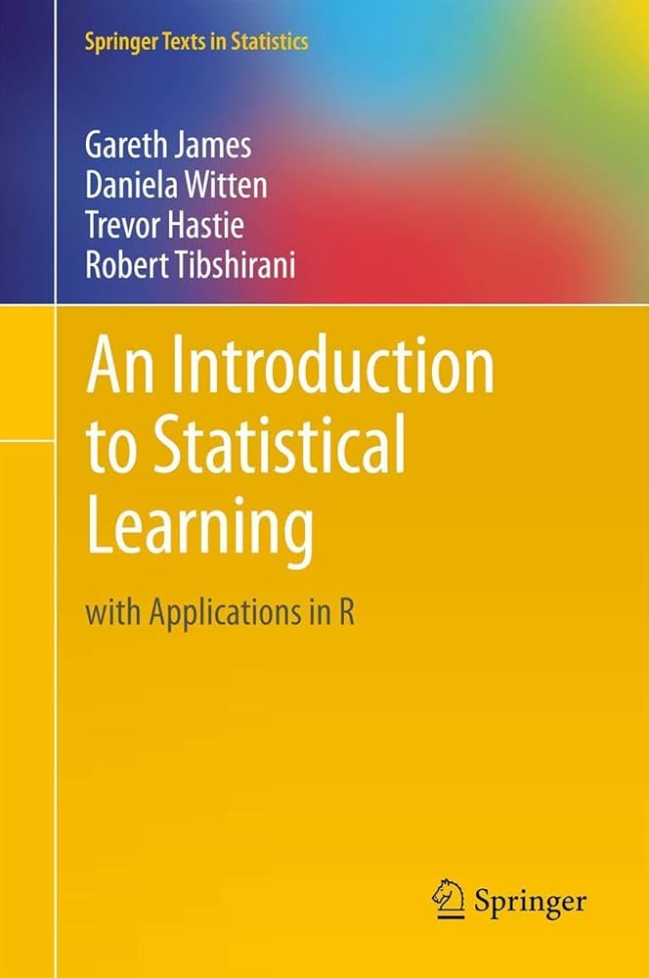
Textbooks
Data Mining and Analysis: Fundamental Concepts and Algorithms by Mohammed J. Zaki and Wagner Meira, Jr.
Optional: An introduction to Statistical Learning (ISLR)

Slide 16
Programming Language and Software
We will use Python as the programming language
We use Jupyter Lab as the IDE for the course, please make sure that you have installed this before the next session.
https://www.datacamp.com/tutorial/installing-jupyter-notebook
Have your laptop with you for in-class activities.

Slide 17
Communication
Post your questions on MSU CSCI Discord channel.
CSCI-347-DATA-MINING (CATEGORY)
I will post the material on D2L and class GitHub page.
I will use GitHub page for updating the schedule.
https://github.com/adiesha/CSCI347Spring2025

Slide 18
Pre-requisites
Students are expected to have taken statistics/probability course and have basic working experience in programming.

Slide 19
Evaluation and grading
Grading | Weight of each category (from 100)
Quizzes | 10
Assignments | 30
Mini projects (3 projects) | 30
Mid-term exam | 10
Final Project | 20
Bonus (depending on the situation and this is entirely up to me) | Up to 2
Total | 100 + (up to 2)

Slide 20

Quizzes
D2L weekly or per topic quizzes (you can expect lot of quizzes)
But these quizzes will be relatively short.
No makeup quizzes, I will drop lowest quiz from your overall grade.

Slide 21
Assignments
There will be written assignments about every other week or after completing each chapter.
The assignments should be turned in on D2L.
For coding assignments, you can submit the JupyterLab files along with other written materials.

Slide 22
Mini Projects
There will be 3 mini projects.
They should be submitted as a well-commented report in PDF format along with your code.
The mini-projects should be completed in teams of 3-4 members.
This is a must. Since we have lot of students, individual project grading is too much for the TA for timely grades.
If you create groups of 1 or 2 people, then there will be a penalty.
Only one submission is required. (Multiple submissions by different people will result penalties)

Slide 23
Final project
Students should propose a data mining problem and dataset and offer a solution using the methods we learn in class.
Groups of 3-4 students.
More information will be shared during the semester.

Slide 24
Assignment 0 – About You
Please update your D2L photo.
Please create a single slide with the following information.
Your name (with pronunciation hints).
Hometown/Country (optional).
Your major.
One thing you would like to learn from this course.
One interesting fact about you.
Convert it to a pdf and submit it.

